Slide 1
Selecting the best location for an Italian Restaurant

Slide 2
Best Location Criteria
A neighborhood with no italian restaurants
A neighborhood where the number of restaurants is less than 5
A neighborhood which is accessible through metro/bus

Slide 3
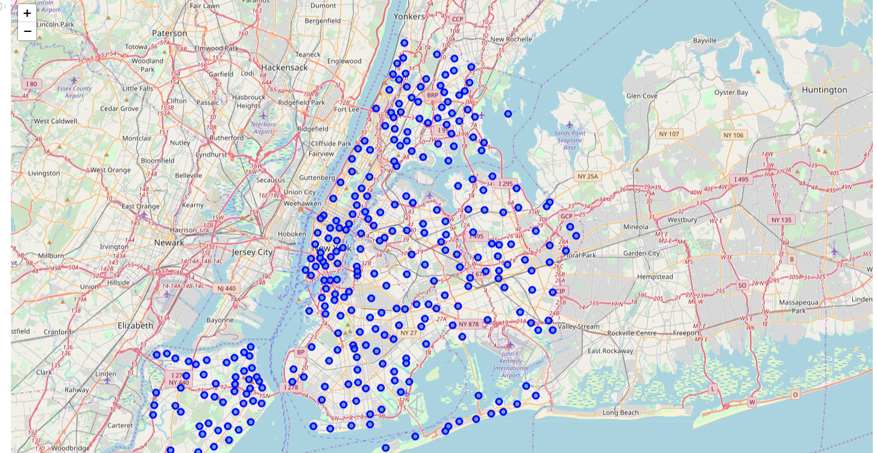
New York has 306 neighborhoods

Slide 4
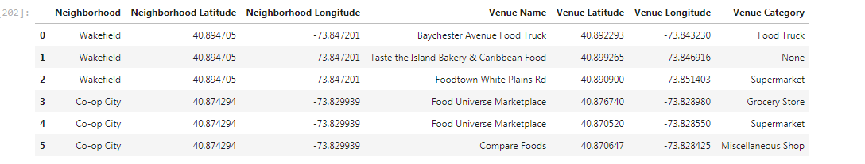
Using Forsquare Api to determine the restaurants in each neighborhood

Slide 5
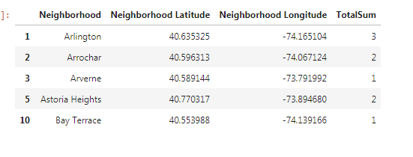
Selecting only neighborhoods with required criteria

Slide 6
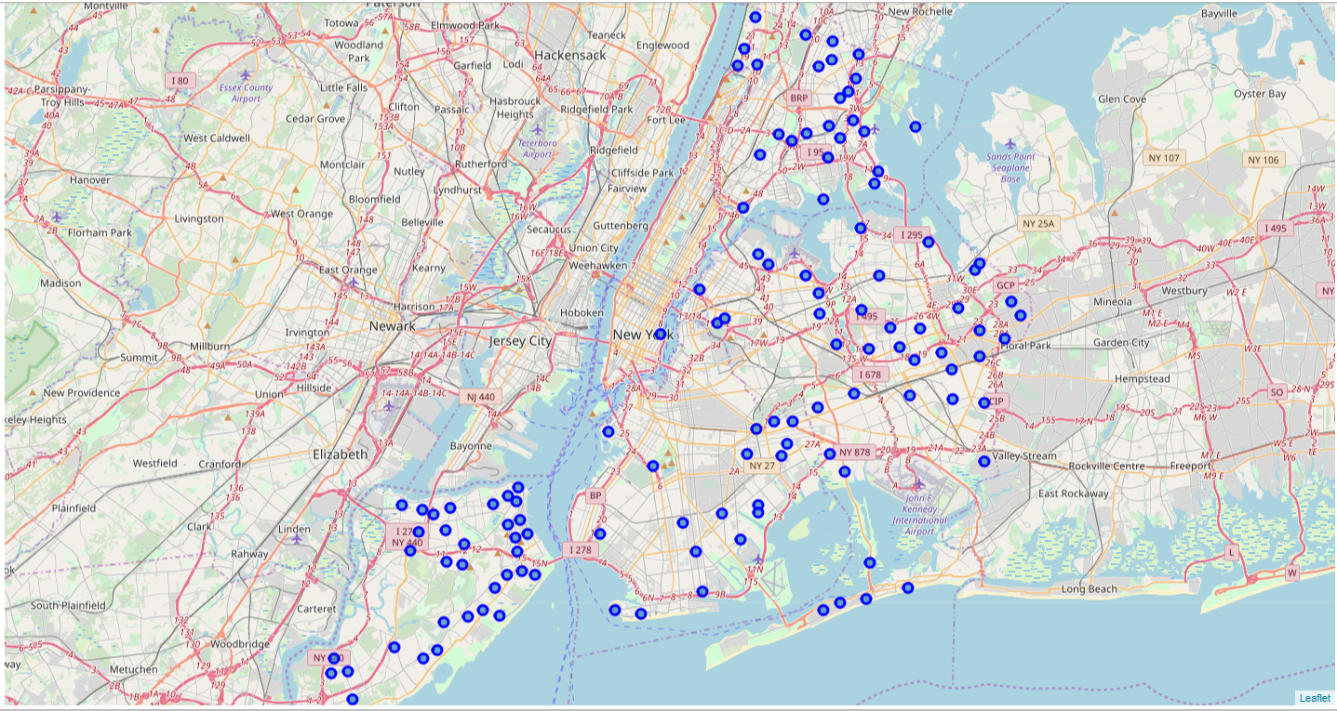
Map View of the results

Slide 7
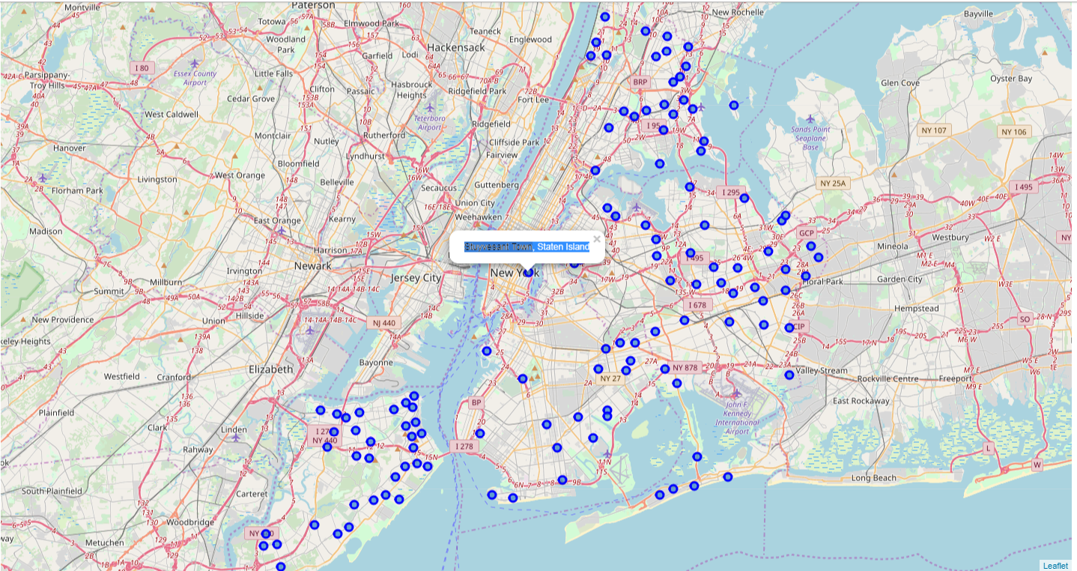
Best Neighborhood in manhatten is :Stuyvesant Town, Staten Island

